Slide 1

On Becoming a Leader in Risk Management
Fundamentals of RM
RM System and Process
Leadership in RM
Incident Investigation
RM Tools & Challenges
RM in Industry
People & Org.
Applications & Perspectives
ENGG404 – Lecture
Chapter 6.4: Professionalism, and Applications of Incident Investigation and Professional Engineer’s Responsibilities
1
Notes:
ENGG404 2014F
1
ENGG404 Lecture 00 - Day 1
2012 Fall
1
1
28 October 2019

Slide 2
Learning Outcomes
Apply key concepts, principles, and practices of risk management in analyzing a loss incident, identifying what went wrong, and determining an appropriate course of action.
This lecture is an opportunity to apply – put into practice – some of the principles, practices, and knowledge that we have been learning the past few lectures. Specifically:
Case 8 MMA Lac Megantic LI, some facts
Chapter 6.3: OH&S Regulatory Framework, Engineering under Alberta OH&S Code, Part 3 Specifications and Certifications, Section 12 Following specifications
Chapter 6.4: Professionalism, Ethics and Equity, Integrity, Conflict of Interest – Your Professional Responsibilities
Chapter 6.4: Professionalism, Ethics and Equity, Integrity, Conflict of Interest
2
Notes:
ENGG404 2014F
2
2
28 October 2019

Slide 3
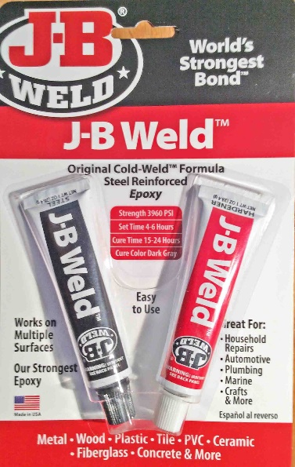
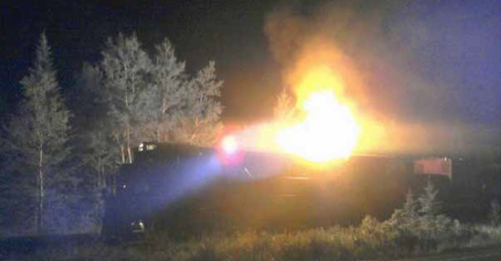
Case 8 Lac-Mégantic / MMA Train Disaster
In October 2012, eight months before this accident, the lead locomotive was sent to MMA’s repair shop following an engine failure.
Given the significant time and cost of a standard repair, and the pressure to return the locomotive to service (RTS), the engine was repaired with an epoxy-metal-like material that lacked the required strength and durability i.e. a temporary repair.
This material failed in service, (8 months later) leading to engine surges and excessive black and white smoke.
Eventually, oil began to accumulate in the body of the turbocharger, where it overheated and caught fire on the night of the accident.
In process safety terms, this is the “triggering event”
*Based on Transportation Safety Board (2014 a and b) – with permission

Slide 4
Chapter 6.3: OH&S Regulatory Framework in Canada, Engineering under Alberta OH&S Code:
Specific responsibilities for professional engineers:
Part 3 Specifications and Certifications
12 Following specifications:
An employer must ensure that
(a) … (b) … (c) … (d) equipment and supplies are erected, installed, assembled, started, operated, handled, stored, serviced, tested, adjusted, calibrated, maintained, repaired, and dismantled in accordance with the manufacturer’s specifications or the specifications certified by a professional engineer.
4

Slide 5
Professionalism and Application:
As a professional engineer, your responsibilities can be complex.
Concerning the MMA RR locomotive, was the engine repaired in accordance with manufacturer’s specifications? i.e. What would the OEM (original equipment manufacturer) recommend?
An OEM would recommend repair using a new engine part.
So, no, the repair using epoxy-metal was more than likely NOT repaired in accordance with manufacturer’s spec’ns.
Suppose you are an Investigator with OH&S: in light of the AB OH&S Code Section 12 Following Specifications, what question would you ask?
“Was the engine repair in accordance with manufacturer’s specifications?”
“Or repaired in accordance with specifications certified by a professional engineer?”
5
Notes:
ENGG404 2014F
5
5
28 October 2019

Slide 6
Professionalism and Application:
As a professional engineer, your responsibilities can be complex.
Now suppose you are the professional engineer responsible for the locomotive maintenance and repair program (well prior to the MMA LI).
What choices do you have to repair the locomotive?
Delay RTS, wait for the OEM part, and install the OEM part. Rationale: a temporary repair is unacceptable.
Design & certify a temporary repair using “JB Weld” two-part epoxy, and specify that the temporary repair has a specific limited life-time of operation. (Is it 1 hour, 100 hours, 1000 hours? What will the subject-matter expert specify?)
Blindly approve “rubber-stamp” the design for a temporary repair.
Do nothing – ignore the mechanic’s repair work using “JB Weld” two-part epoxy – and believe that you cannot be held responsible because the work is not under your responsibility / not approved / not authorized / not certified by you / not.
What would you do to repair the locomotive?
Choice 1) or 2).
6
Notes:
ENGG404 2014F
6
6
28 October 2019

Slide 7
Summary:
This lecture was an opportunity to apply – put into practice – some of the risk management principles and practices, and knowledge that we have been learning the past few lectures. Specifically:
Case 8 MMA Lac Megantic LI, some facts
Chapter 6.3: OH&S Regulatory Framework, Engineering under Alberta OH&S Code, Part 3 Specifications and Certifications, Section 12 Following specifications
Chapter 6.4: Professionalism, Ethics and Equity, Integrity, Conflict of Interest – Your Professional Responsibilities
Chapter 6.4: Professionalism, Ethics and Equity, Integrity, Conflict of Interest
7
Notes:
ENGG404 2014F
7
7
28 October 2019

